Slide 1
network intrusion detection system (NIDS) using machine learning
IBM SKILLS BUILD & AICTE PROJECT
Presented By:
Student Name- SHACHIN P R
College Name- GOVERNMENT COLLEGE OF ENGINEERING,ERODE
Department- CSE (I-YEAR)

Slide 2
OUTLINE
Problem Statement
Proposed System/Solution
System Development Approach
Algorithm & Deployment
Result
Conclusion
Future Scope
References

Slide 3
Problem Statement
Network Intrusion Detection The Challenge: Create a robust network intrusion detection system (NIDS) using machine learning. The system should be capable of analyzing network traffic data to identify and classify various types of cyber-attacks (e.g., DoS, Probe, R2L, U2R) and distinguish them from normal network activity. The goal is to build a model that can effectively secure communication networks by providing an early warning of malicious activities.

Slide 4
Proposed Solution
Kaggle’s Network Intrusion Detection Dataset
To address this challenge, we propose a machine learning-based NIDS built using IBM AutoAI. The system automatically selects the best model pipeline to classify network traffic and detect intrusions.
Key components include:
Data Collection: Used a labeled dataset with 22,544 records containing network traffic features and attack labels
from Kaggle’s Network Intrusion Detection Dataset
Data Preprocessing: AutoAI handled feature transformation, encoding, and missing value treatment automatically.
Model Training: AutoAI generated 8 pipelines and selected the best-performing one (Snap Decision Tree Classifier) with 99.5% accuracy.
Prediction Output: The model classifies traffic as either anomaly or normal with high confidence (90–100%).

Slide 5
System Approach
Platform Used:
IBM watsonx.ai Studio (AutoAI + Deployment)
Steps Followed:
Uploaded dataset and selected target column (class)
AutoAI generated multiple pipelines and evaluated them
Logs confirmed smooth execution in under 3 minutes
Model deployed directly via IBM watsonx.ai Studio—no manual coding required
System Requirements:
IBM Cloud Lite account
AutoAI tool access
IBM watsonx.ai Runtime (Python 3.x) for model execution and deployment
IBM watsonx.ai Deployment interface
Libraries Required (for integration only):
IBM Cloud SDKs (optional for API integration)
IAM token setup for secure access

Slide 6
Algorithm & Deployment
Algorithm Selected: Snap Decision Tree Classifier (AutoAI-selected)
Why This Algorithm:
High accuracy (99.5%)
Fast training time (9 seconds)
Interpretable and efficient for real-time detection
Training & Testing:
Kaggle’s Network Intrusion Detection Dataset
Train_data.csv (125,973 rows) & Test_data.csv (22,544 rows)
Target column: class (normal vs attack)
Training Process: AutoAI used 10% of training data for initial selection, then optimized top pipelines using
hyperparameter tuning.
Deployment Strategy:
Model deployed using IBM watsonx.ai Studio’s built-in deployment feature
Generated public and private scoring endpoints
No Flask or Python required—ready-to-use REST API provided by IBM
Supports integration via cURL, Java, JavaScript, Python, Scala
Data:

Slide 7
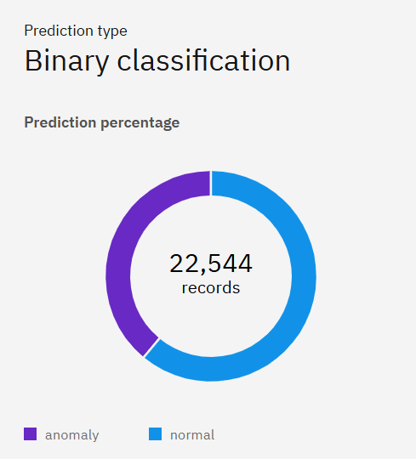
Result
Prediction Type: Binary classification (Anomaly vs. Normal)
Total Records Analyzed: 22,544
Class Distribution:
Anomaly (Purple):
Represents malicious or suspicious network activity
Normal (Blue):
Represents safe, expected traffic
Model Confidence:
High—most predictions fall in the 90–100% confidence range
Insight:
The model effectively distinguishes between normal and anomalous traffic, supporting its use in real-time intrusion detection
Visualization Purpose:
Confirms balanced classification and strong model generalization

Slide 8
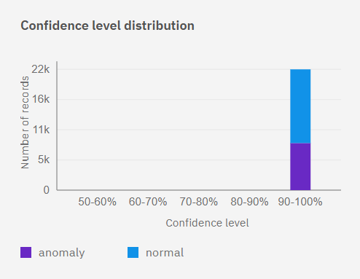
Result
Chart Title: Confidence Level Distribution
Confidence Range: All predictions fall within the 90–100% confidence bracket
Class Breakdown:
Normal (Blue): ~17,000 records
Anomaly (Purple): ~5,000 records
Interpretation:
The model shows high reliability in its predictions, with no records falling below 90% confidence
Significance:
This strong confidence distribution supports the model’s robustness and suitability for real-time deployment in network intrusion detection
Visual Insight:
The bar chart confirms that both anomaly and normal classifications are made with high certainty, reducing false positives and negatives

Slide 9
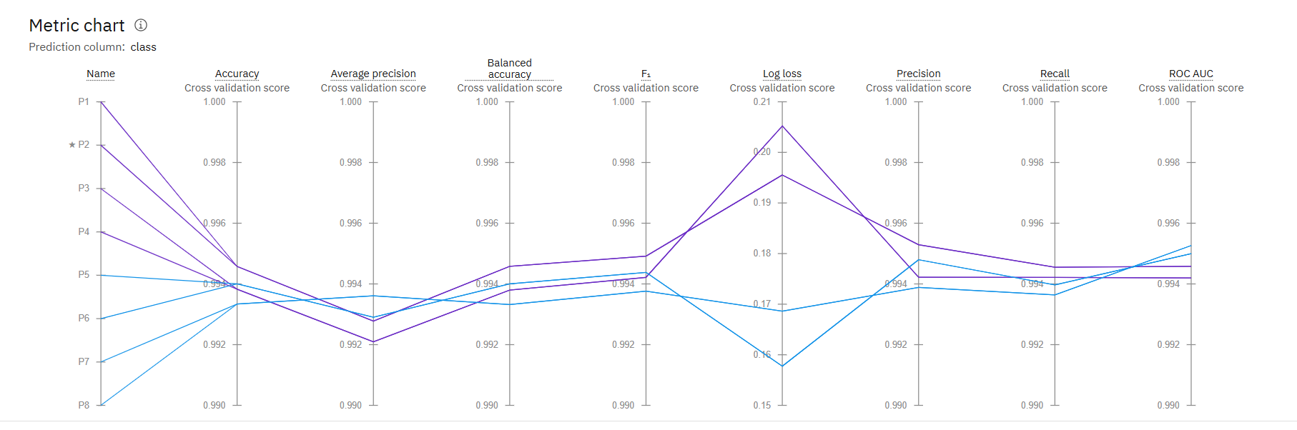
Result
Best Pipeline Selected: ⭐ P2 – Snap Decision Tree Classifier
Build Time: ~9 seconds
Confidence Range: 90–100% for most predictions
.

Slide 10
Conclusion
The proposed NIDS successfully detects network intrusions using machine learning. IBM AutoAI and watsonx.ai Studio streamlined the entire process—from data preprocessing to model selection and deployment—resulting in a highly accurate and efficient classifier. The Snap Decision Tree model is now deployed via IBM’s cloud-native interface, offering secure and scalable access through REST APIs

Slide 11
Future scope
Integrate Real-Time Traffic Monitoring and Prediction Enhance the system to ingest and analyze live network traffic for immediate threat detection.
Expand to Multi-Class Classification for Attack Types Move beyond binary classification to identify specific attack categories like DoS, Probe, R2L, and U2R.
Deploy on Edge Devices for Faster Response Optimize models for lightweight deployment on routers, gateways, or Raspberry Pi for low-latency detection.
Use Advanced Models like LSTM for Sequential Traffic Analysis Incorporate deep learning models to capture temporal patterns in network flows and improve accuracy.
Build a Dashboard Using Streamlit for Live Visualization Create an interactive frontend to monitor predictions, traffic stats, and alerts in real time.
Integrate Threat Intelligence Feeds Enrich detection by correlating traffic with known malicious IPs, domains, and signatures.
Enable Auto-Retraining with New Data Set up pipelines to periodically retrain models using fresh traffic data to adapt to evolving threats.
Benchmark Against Industry Standards (e.g., CICIDS, UNSW-NB15) Validate model performance using diverse, real-world datasets for robustness.
Collaborate with SOC Teams for Real-World Feedback Integrate the system into Security Operations Centers to gather insights and improve usability.

Slide 12
References
1. IBM watsonx.ai Studio
cloud.ibm.com/catalog/services/watsonxai-studio
2. Kaggle NIDS Dataset
https://www.kaggle.com/datasets/sampadab17/network-intrusion-detection
3. NSL-KDD Dataset Overview
ijert.org
4. AutoAI Anomaly Detection Tutorial
ibm.com/docs
5.Concept of NIDS using AIML
https://youtu.be/BlTK2pPcQaQ?si=lxQHtuz5Ly4PT3_A

Slide 13
GITHUB LINK

Slide 14
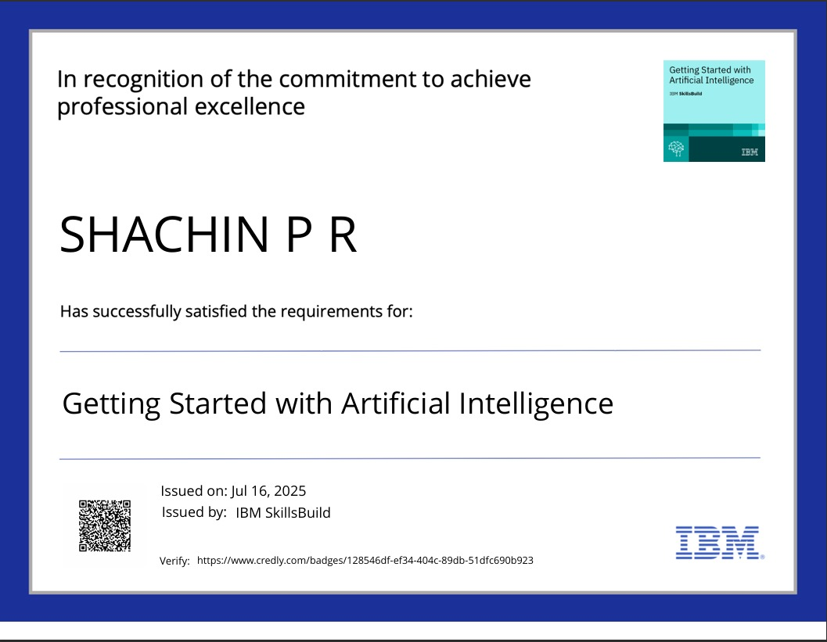
IBM Certifications

Slide 15

IBM Certifications

Slide 16
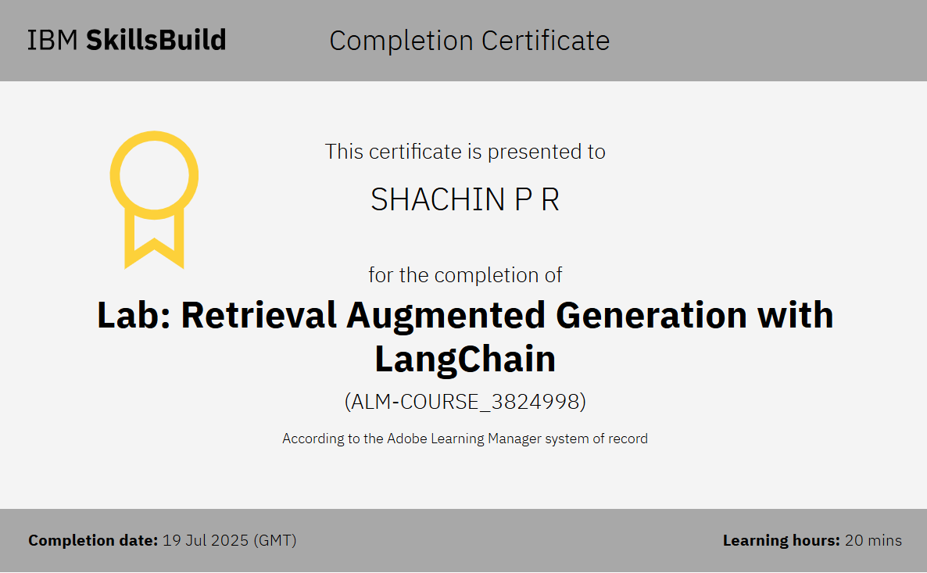
IBM Certifications

Slide 17
THANK YOU

